Slide 1
CO2 Emissions
1999-2014
Brian McLane, Greg Behnke, Katharine Hollars, Steve Reiss

Slide 2
Goals / Hypotheses
Notes:
Steve

Slide 3
Goals:
The COP26 Summit and recent weather-related events have focused attention on the health, political, economic, and national security implications of climate change.
A key global climate change initiative was the 2015 Paris Accords, the first time that most of the world’s leading countries came together to address the topic.
Global climate change is being driven by CO2 emissions. We’ve created visualizations to examine CO2 data from the years 1999 to 2014 - a period when emissions increased significantly - to better understand what world leaders knew as they participated in the Paris Accords.
Notes:
Steve

Slide 4
Hypotheses:
There are over 200 countries being tracked in our DB. Our hypothesis was that CO2 emissions were primary driven by a handful of larger countries. This was confirmed by additional sources.
We hypothesized that certain top 30 countries – primarily China – have contributed an increasing percentage of the emissions, paralleling / tied to their dramatic economic growth.
We hypothesized that certain countries who are not top of mind might be included in this group – who we are calling “the Dirty 30”.
Notes:
Steve

Slide 5
ETL
Notes:
Brian

Slide 6
ETL:
Our ETL goal is to simplify the dataset
Dropping bunker fuels (not included in total)
Reducing the size of the database for faster response (Using years 1999 – 2014
Focusing on top countries who contribute most of the emissions
Next tier: breaking data into regions – e.g. Middle East
Next tier: including data on domestic fossil fuel production, haven’t found a good source yet
Notes:
Brian

Slide 7
ETL:
Our Data was Consumed as Follows
Our primary emissions data originated as a .csv file at DataHub.io by DATOPIAN: https://datahub.io/core/co2-fossil-by-nation#data
Initial data extraction and cleaning was done in Jupyter Notebooks with additional steps performed in PostgreSQL
Final filtered data produced a table of the top 30 CO2 emitting nations by combined total
We utilized Flask, HTML, CSS, JS and graphics (Leaflet, Plotly, D3, chartJS) to display our findings
Notes:
Brian

Slide 8
ETL:
Data Challenges
In our file, countries have changed / countries have merged (e.g. USSR vs. Russia and Ukraine, Germany vs. Democratic Republic of Germany)
We used data from 1999 onward to reduce complexity and avoid confusion
Notes:
Brian

Slide 9
Deployed Infrastructure
Notes:
Greg

Slide 10
Deployed Infrastructure:
Currently runs locally
The goal is to deploy on Heroku
Notes:
Greg

Slide 11
Deployment Learnings…
Notes:
Greg

Slide 12
Deployment Learnings:
Our data was not too big for PostgreSQL. But adding further contextual visualizations (e.g. volcanos, deforestation) might exceed the limitations of the free services
Issues related to name changes with different nations. We reduced our dataset
We were originally thinking of last 50 years, but changed to last 15 years of data only – this changed our leading CO2 emitter
Was this harder than expected?
”You showed us a flame. You explained how steel is forged. Then you asked us to create an internal combustion engine. Oh … and then you mentioned Heroku – whaaaaaa?”
Notes:
Greg

Slide 13
Website
Notes:
Katharine

Slide 14
Website Structure
Served by a Flask app
Three main pages
Home / index: key landing page including two data visualizations
Map: “Dirty 30” coded map and background on CO2 emissions
About: why we created this site, including headshots and links to git repositories for project team members
CSS used for consistent formatting
JS used for visualizations
Map: creating our interactive map
Index: creating our interactive charts (line and stacked bar)
Config: API key for map
JSON to hold data
Notes:
Katharine

Slide 15
Our Planned Webpages…
Notes:
Katharine

Slide 16
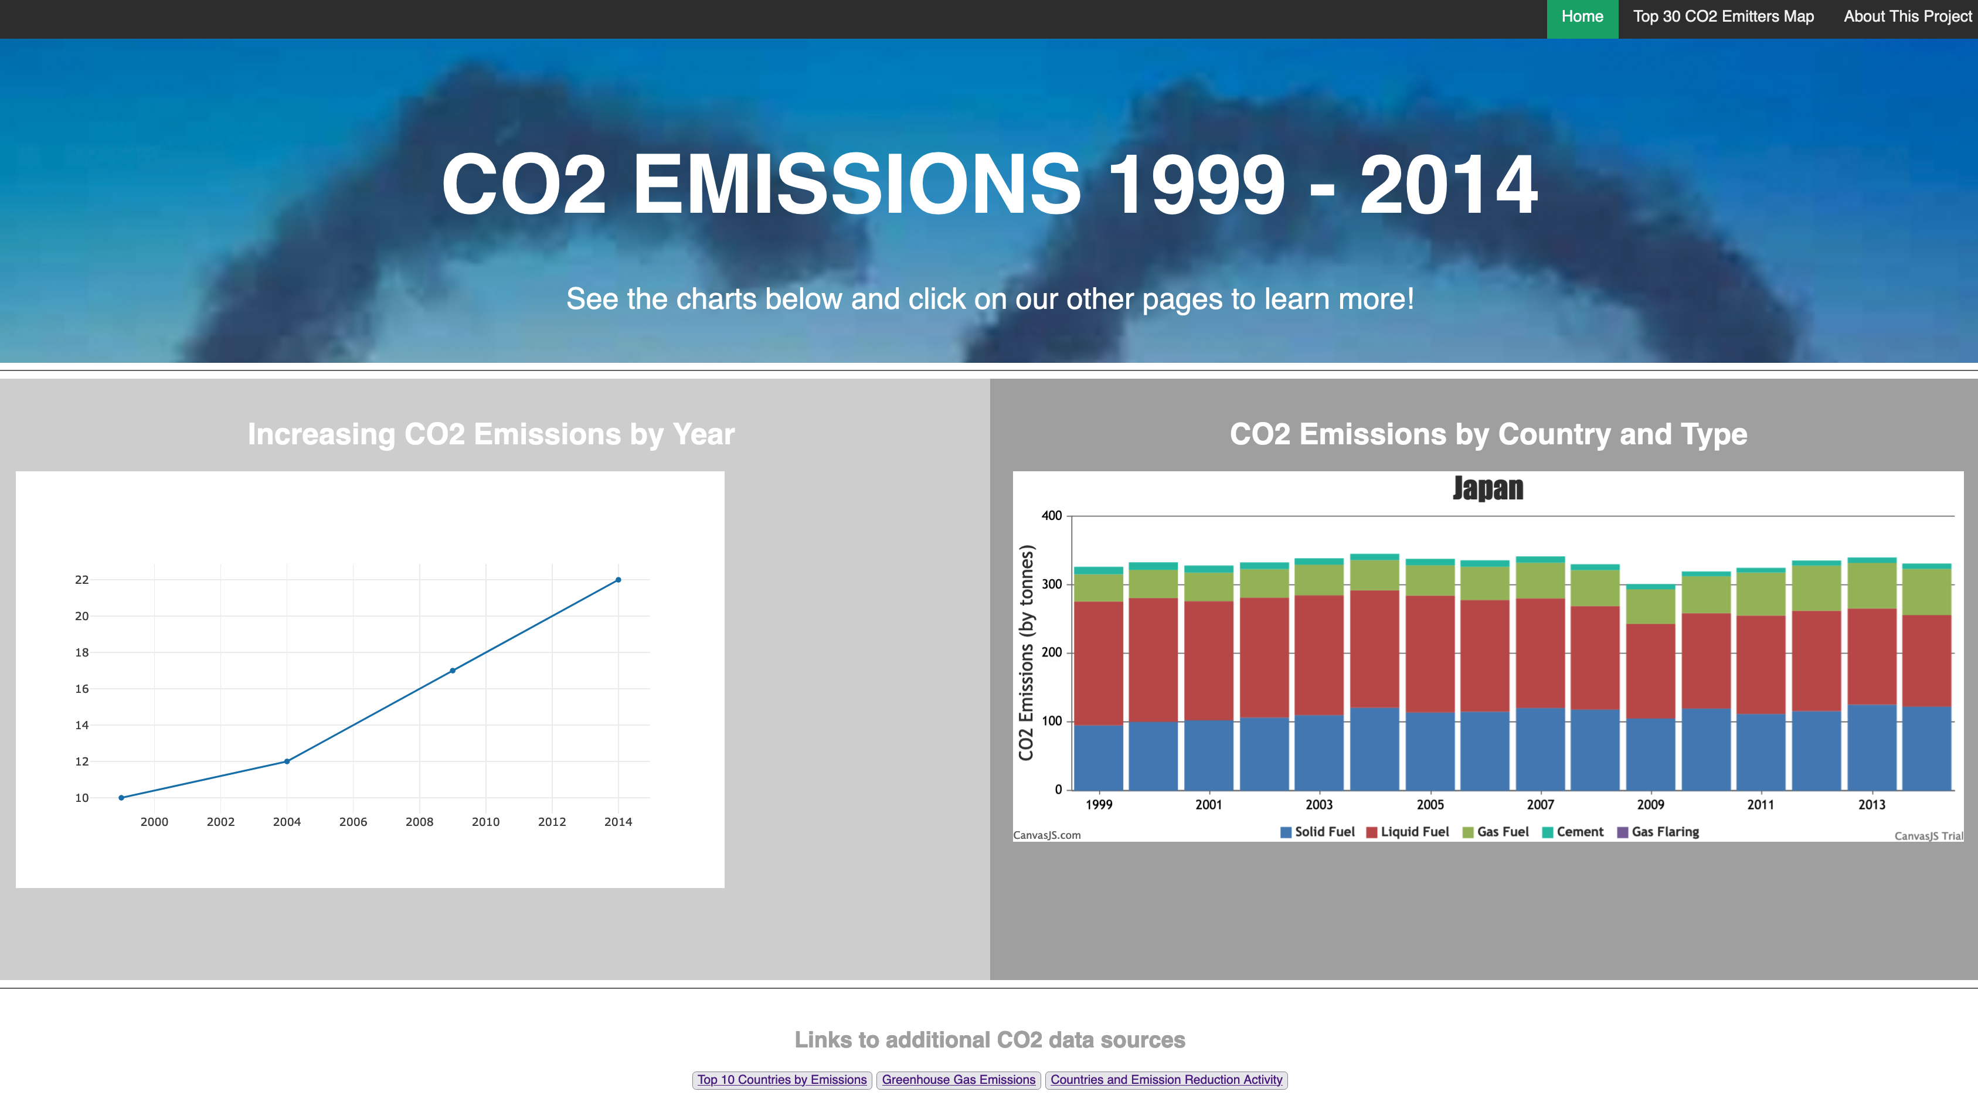
Notes:
Katharine

Slide 17
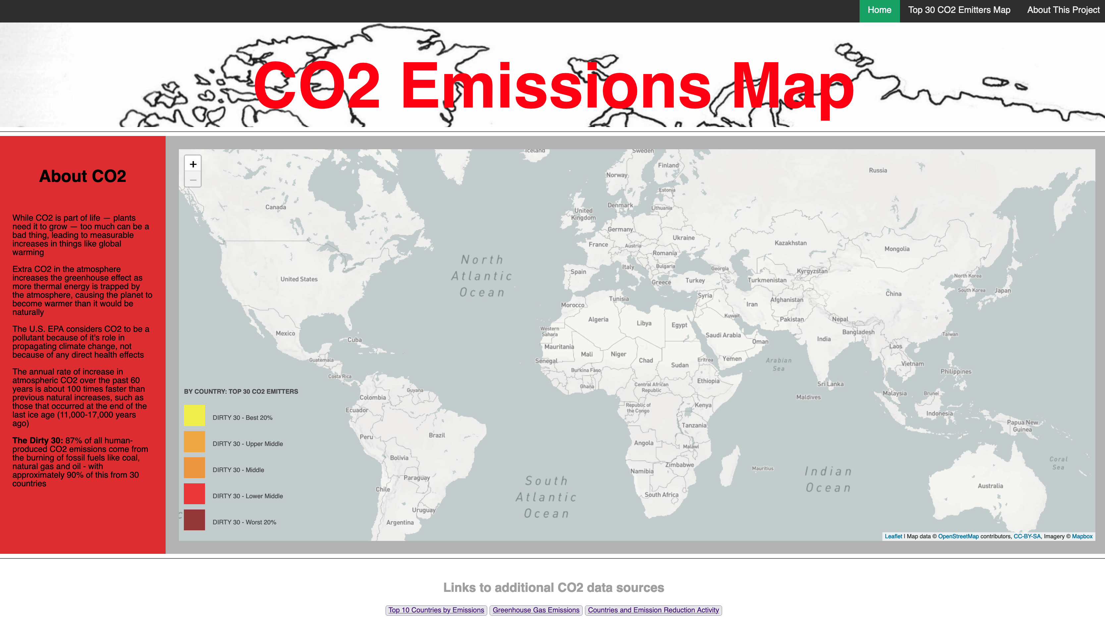
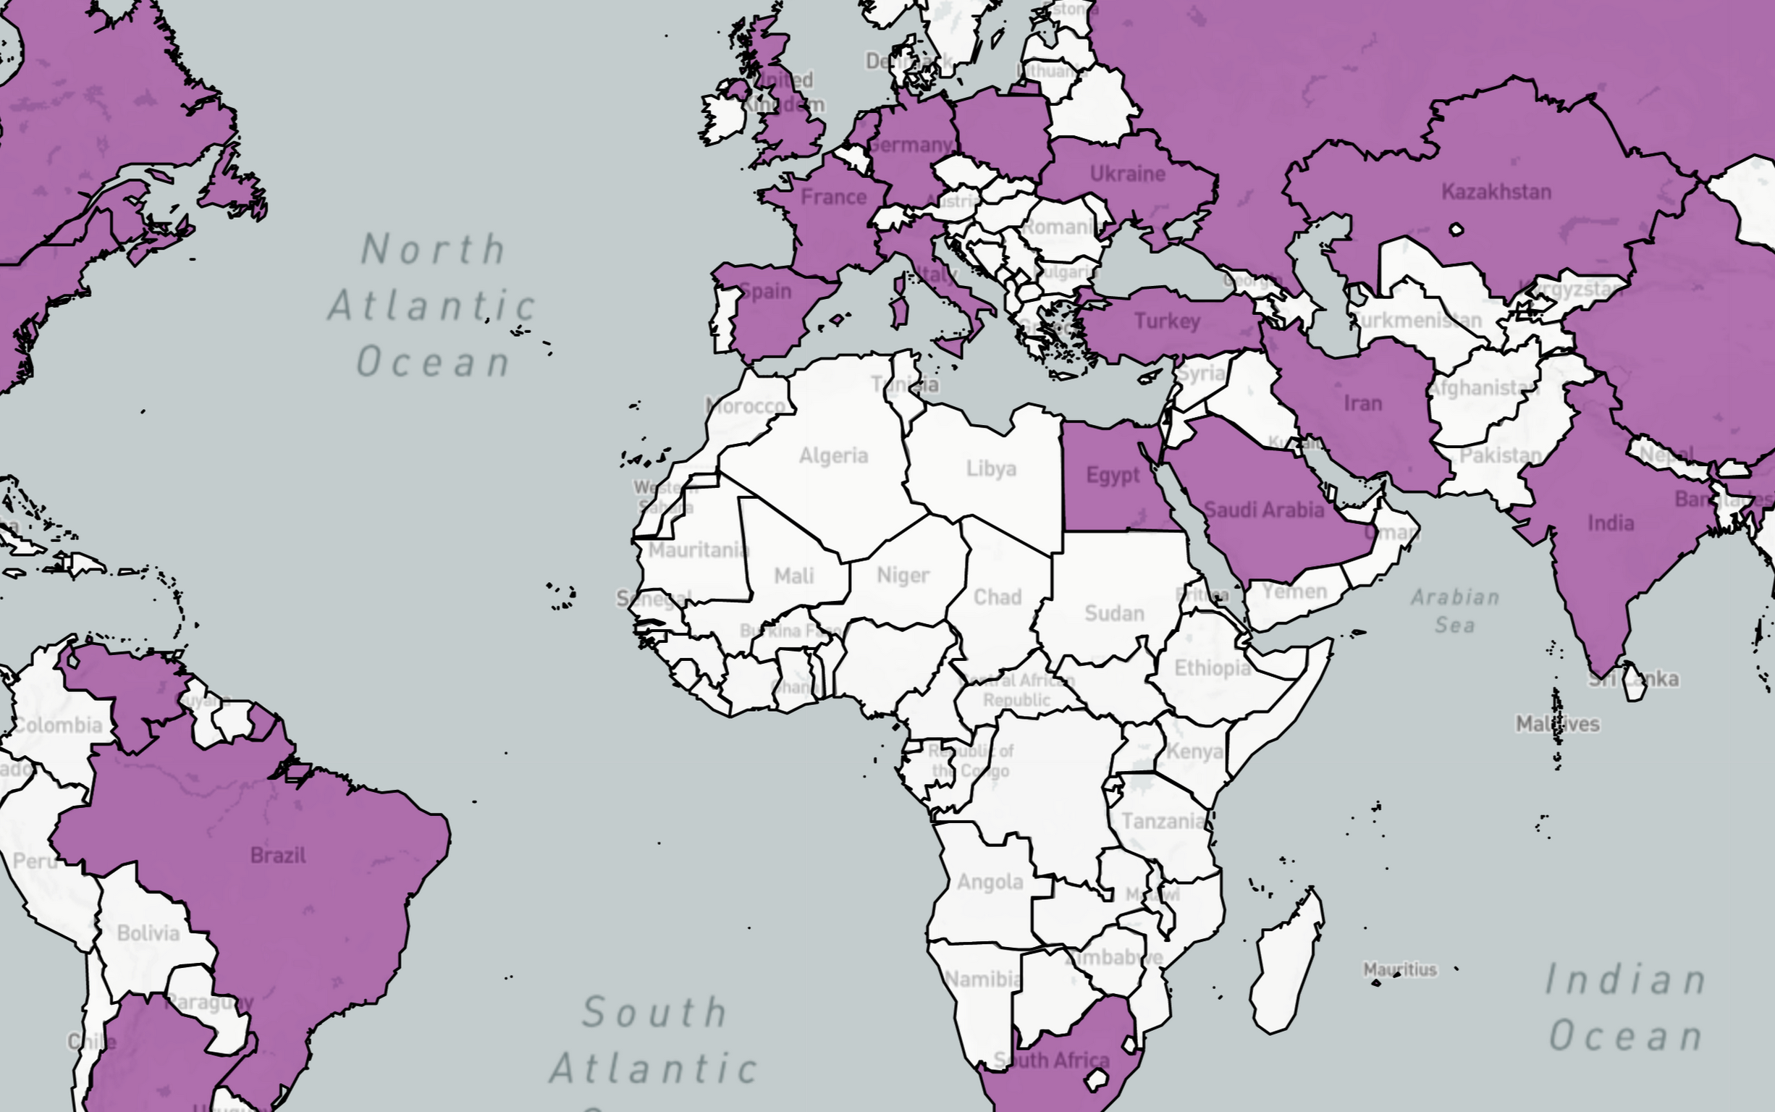
Notes:
Katharine

Slide 18
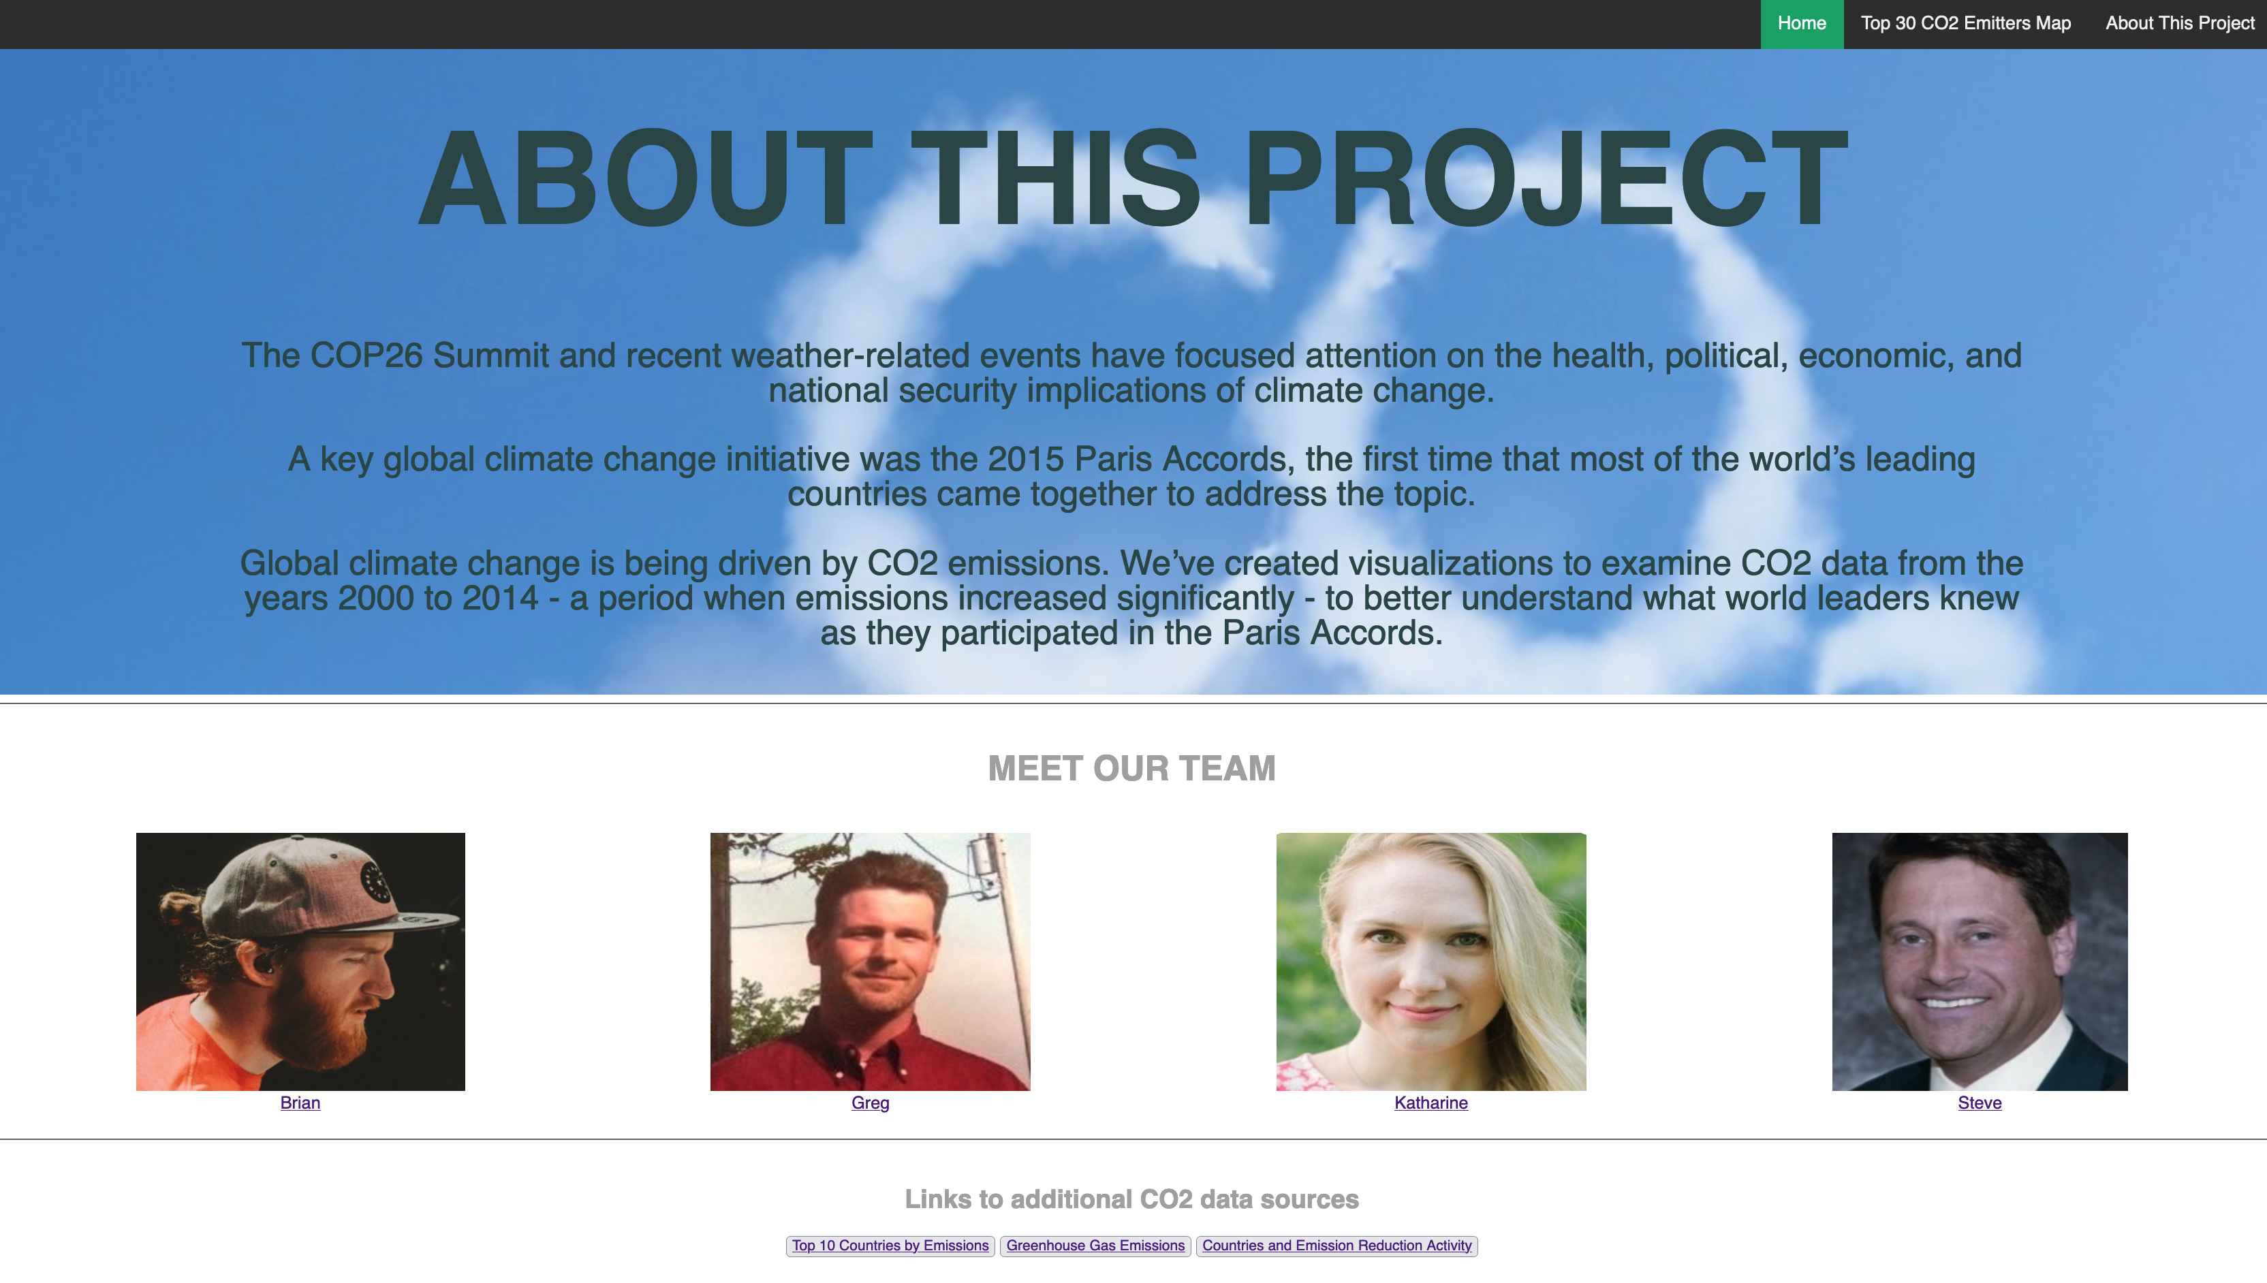
Notes:
Katharine

Slide 19
Live Demo
Our Current Status…
Notes:
Greg - walk thru live site

Slide 20
Next Steps, WrapUp and Closing Thoughts…
Notes:
One thought from each team member?

Slide 21
Next Steps and Closing Thoughts
Next Steps:
Visualizations with interactive capabilities – by country, year, region, type of emissions, etc.
Make our map an interactive heatmap
Identify and layer in related data as appropriate – deforestation, climate pledges, domestic fossil fuel production, etc.
Hosting – Heroku?
Closing Thoughts:
Greater team alignment related to planning our product, process, responsibilities, scope, timelines, deliverables - in some cases our expectations were not consistent
More consistent team communications (and consensus) during the project (progress, challenges, suggested workarounds, when we needed external help, etc.)
Notes:
Greg

